Slide 1
MVP Presentation - ByteForge22
Idea Title : Multilingual AI-Powered Clinical Documentation & Decision Support System
Team Captain Name : Aadya Kasi Reddy
Team Members : Adithi Vaidya, Aishani Pureddiwar, Ramavath Poojitha
Team Name : ByteForge22
© 2025–2027 Cognizant | Private

Slide 2
Multilingual AI-Powered Clinical Documentation & Decision Support System
Problem Statement
Solution Description
Healthcare professionals spend 40-60% of their time on documentation and EHR updates, reducing patient-facing time. Manual entry causes inconsistent records, delays in treatment, and increased clinician burnout. In multilingual settings, language gaps between patients and clinicians introduce misinterpretation and errors.
A real-time multilingual AI system that captures doctor-patient consultations, converts speech to text, translates across languages, and generates structured clinical notes (SOAP format). Provides EHR-ready outputs and optional decision support such as ICD code suggestions - without disrupting clinician workflow.
© 2026 Cognizant

Slide 3
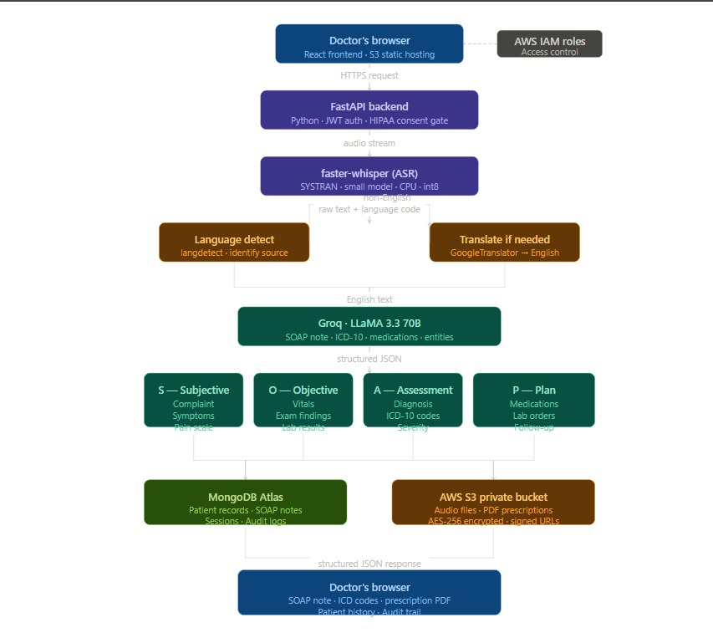
Multilingual AI-Powered Clinical Documentation & Decision Support System
Technical Design and architecture
Frontend:
• React + Vite
Backend:
• FastAPI (Python)
Authentication:
• JWT-based secure authentication
• bcrypt password hashing
AI Pipeline:
• Faster-Whisper for multilingual ASR + language detection
• Groq API with Llama 3.3 70B for SOAP note generation
Cloud & Storage:
• MongoDB Atlas for clinical records
• AWS S3 for audio and prescription storage
Document Generation:
• ReportLab for prescription PDF creation
© 2026 Cognizant
** Use additional slides to include other relevant details, as required.

Slide 4
Multilingual AI-Powered Clinical Documentation & Decision Support System
Uniqueness / Innovativeness
Business Impact
- Combines multilingual ASR, real-time translation, and clinical NLP in a single pipeline
- Context-aware SOAP note generation; no comparable all-in-one multilingual clinical tool exists
-Use of NLP over LLM
- ~50% reduction in documentation time; improved record accuracy
- Faster billing/claims cycles; reduced clinician burnout
- SaaS revenue model; scalable across hospitals, clinics, telemedicine
© 2026 Cognizant

Slide 5
Multilingual AI-Powered Clinical Documentation & Decision Support System
Scalable / Reusable
Roadmap
- Cloud-native (AWS/Azure) with pay-as-you-scale model; low MVP cost
- Easily configurable for hospitals, clinics, telemedicine platforms globally
- SaaS licensing model; supports multi-language regions (esp. India)
-Use of PHI for sensitive details healthcare redaction.
- Week 1: Research, data flow design, UI wireframes
- Week 2: ASR + NLP integration and basic pipeline
- Week 3: Backend-frontend integration and EHR-ready formatting
- Week 4: Testing, optimization, demo preparation
© 2026 Cognizant

Slide 6
Thank you
© 2026 Cognizant

